Slide 1

Cuisine Mining
Harish annavajjala
Chirag chheda
Abhinandan sampathkumar
Siddharth jayashankar

Slide 2
Background
74% of online adults use social networking sites.
Twitter has 320M monthly active users.
Food is our common ground, a universal experience.
Insights to such a fundamental concept seems appealing.
195 countries present, numerous cuisines available

Slide 3
Possible Insights and Visualizations
Popularity of a cuisine around the world.
Most preferred dish of each cuisine around the world.
How varied are people’s choice of food and cuisine.
What food is preferred for each meal of the day.
How varied are the ingredients between cuisines.

Slide 4
DATA – Collection & Preprocessing
We mined twitter data using its Streaming and Rest API.
A rich dataset was collected from University of Arizona . (Data set from the Paper - Analyzing the Language of Food on Social Media )
We chose the top 10 cuisines of the world ( Cuisines considered: Australian, Chinese, French, Indian, Italian, Japanese, Lebanese, Mexican, Spanish and Thai )
Each cuisine is associated to its most popular dishes.
Processed the data available to make it consistent.
The processed data was stored in a MySQL & MongoDB databases.

Slide 5
Tools & Technology used
Twitter API & BigOven API (recipe website)
Python, Java
JavaScript, HTML
Google Geo Charts, D3.js
MySQL and MongoDB
Microsoft Excel

Slide 6
Visualization Used
Word cloud - To show impact of ingredients on a cuisine.
Clustered Column graph - To find preferences of dishes over different meals of the day.
Stacked Bar – To find the affinity of a particular cuisine among different countries.
Pie Charts - To find the share of all dishes in a particular cuisine.
Geo Map – To find the top dishes in a country

Slide 7
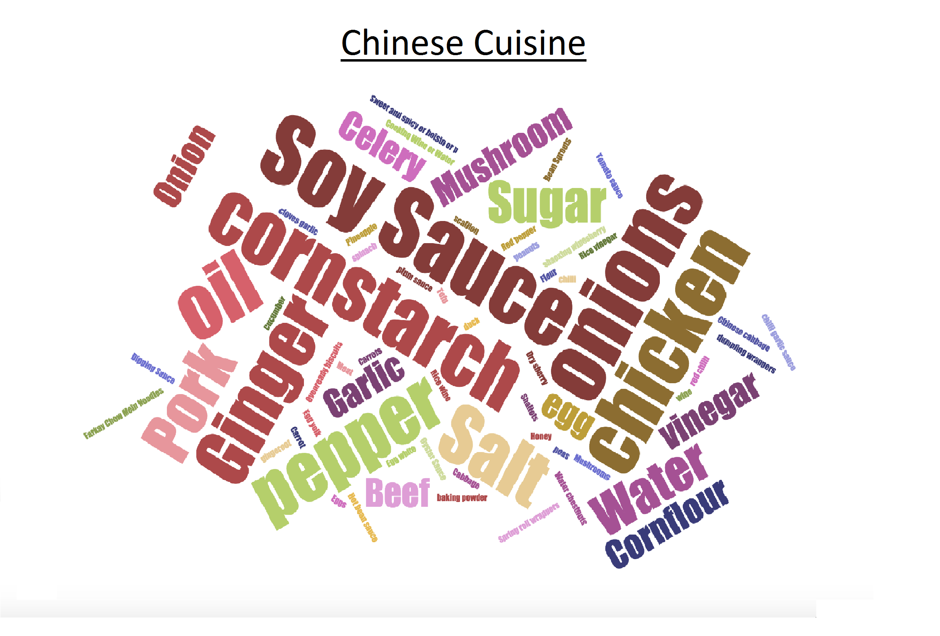
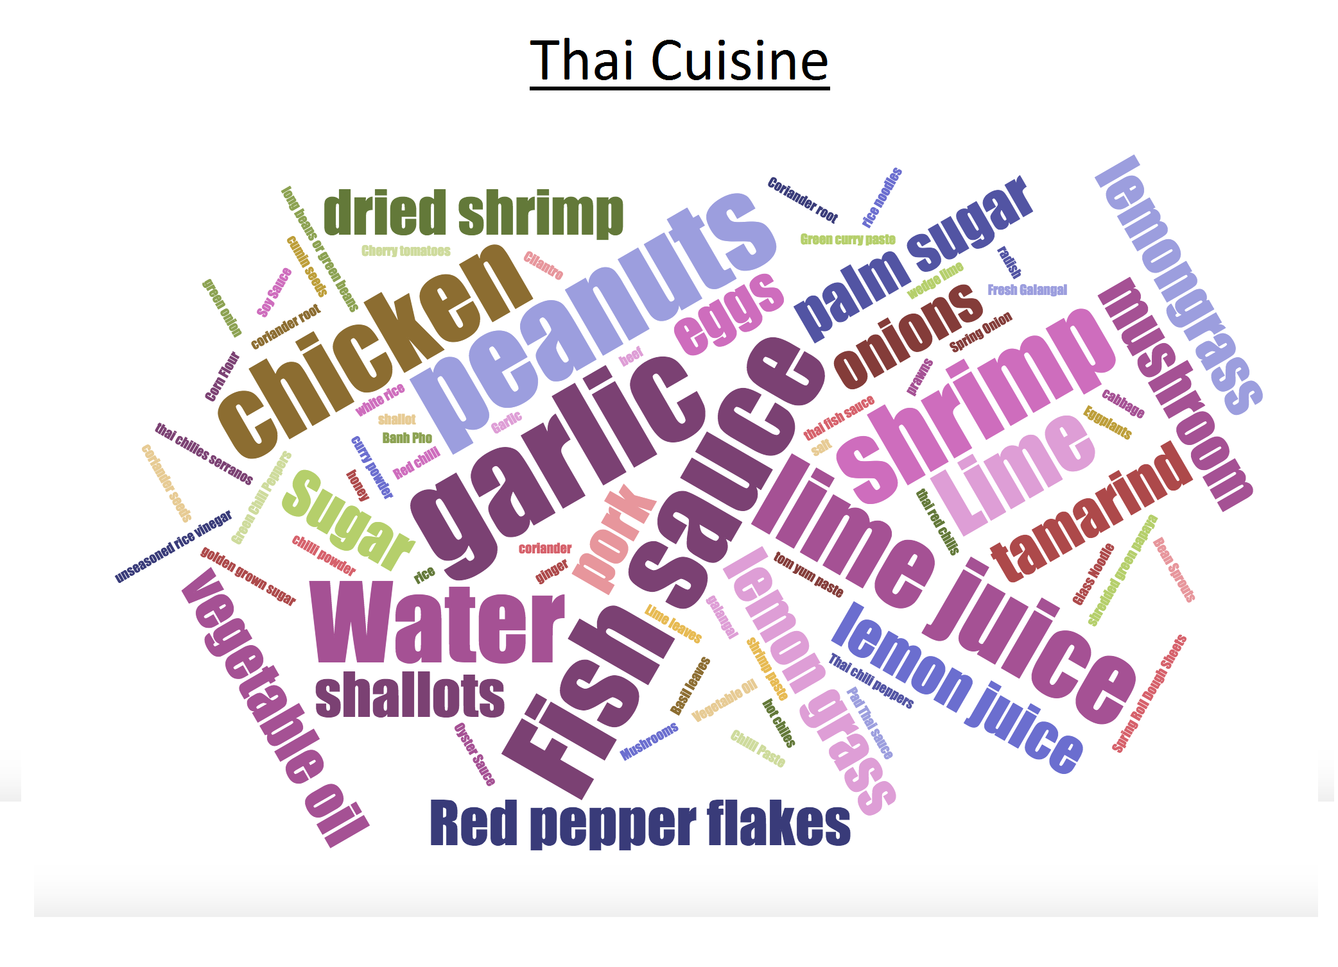
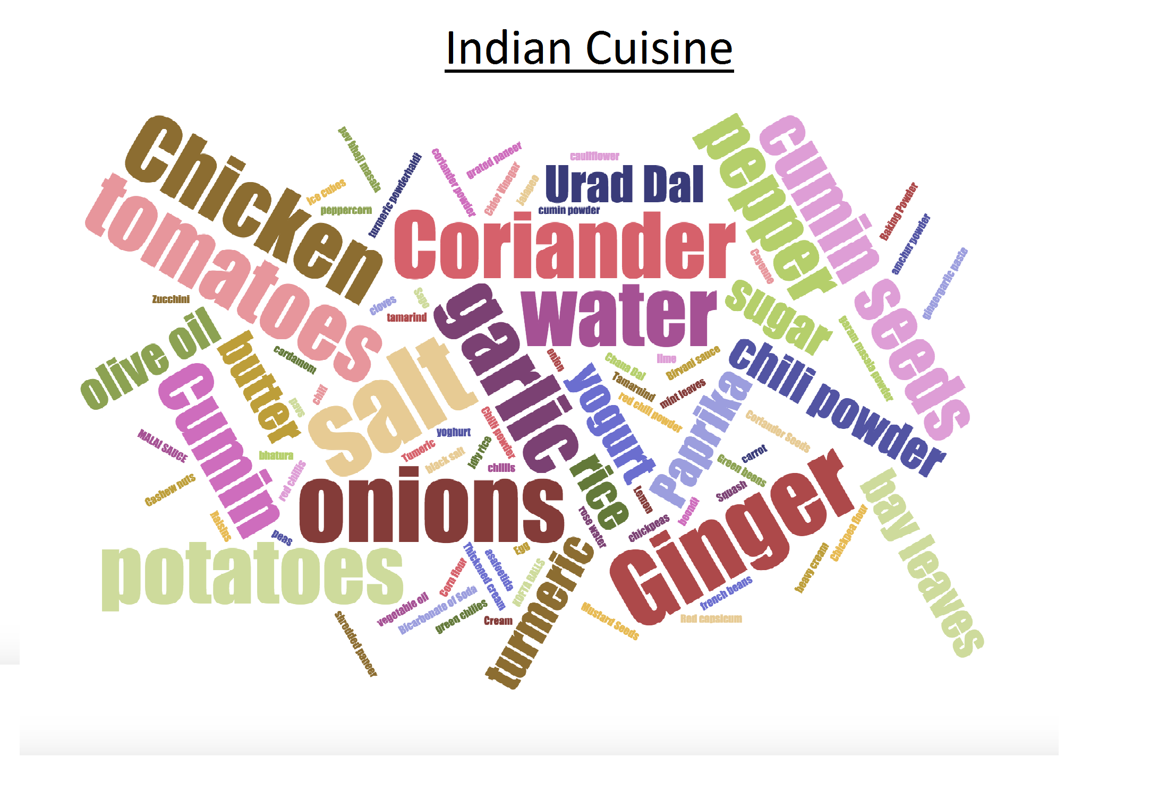
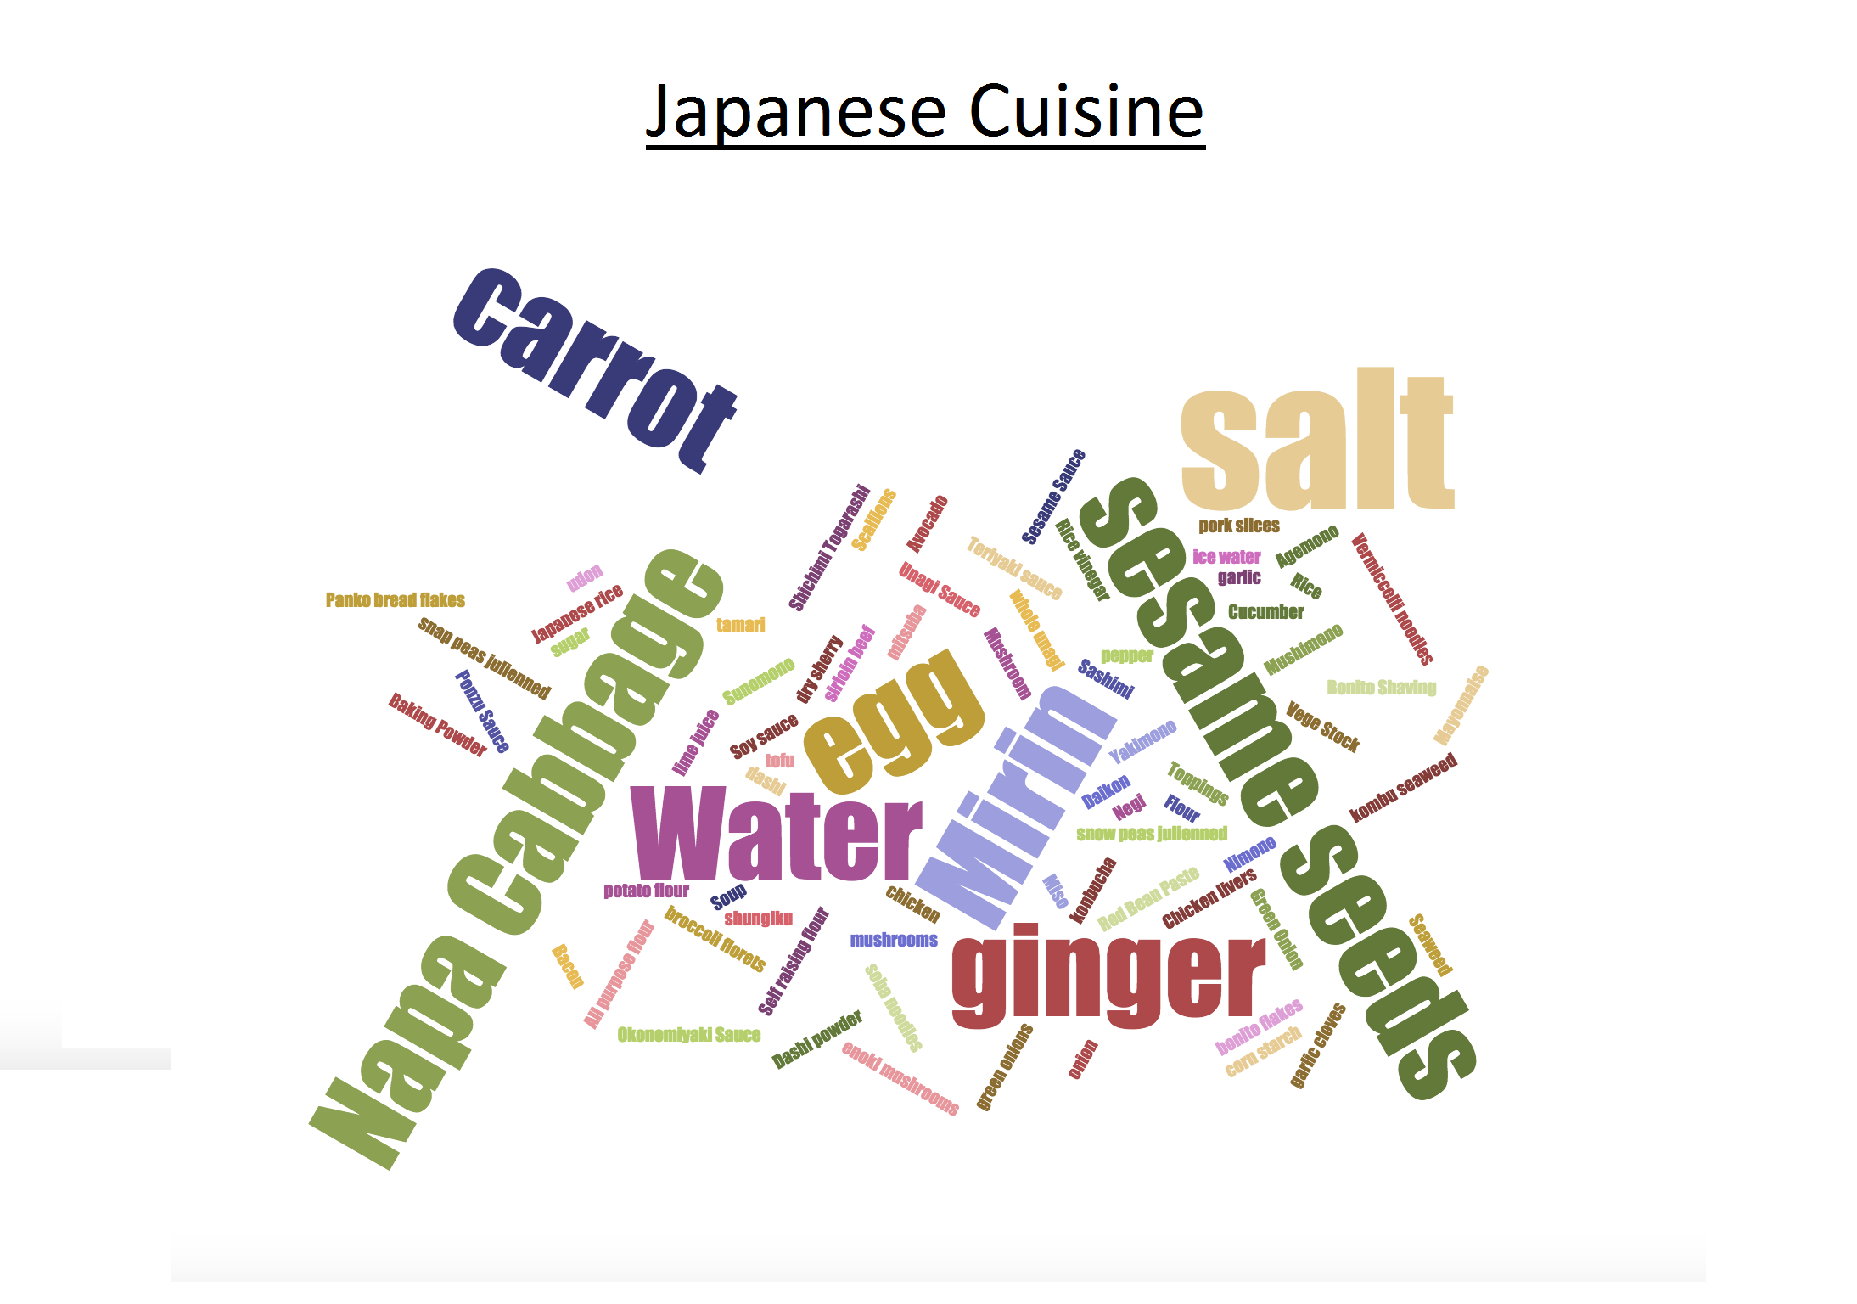
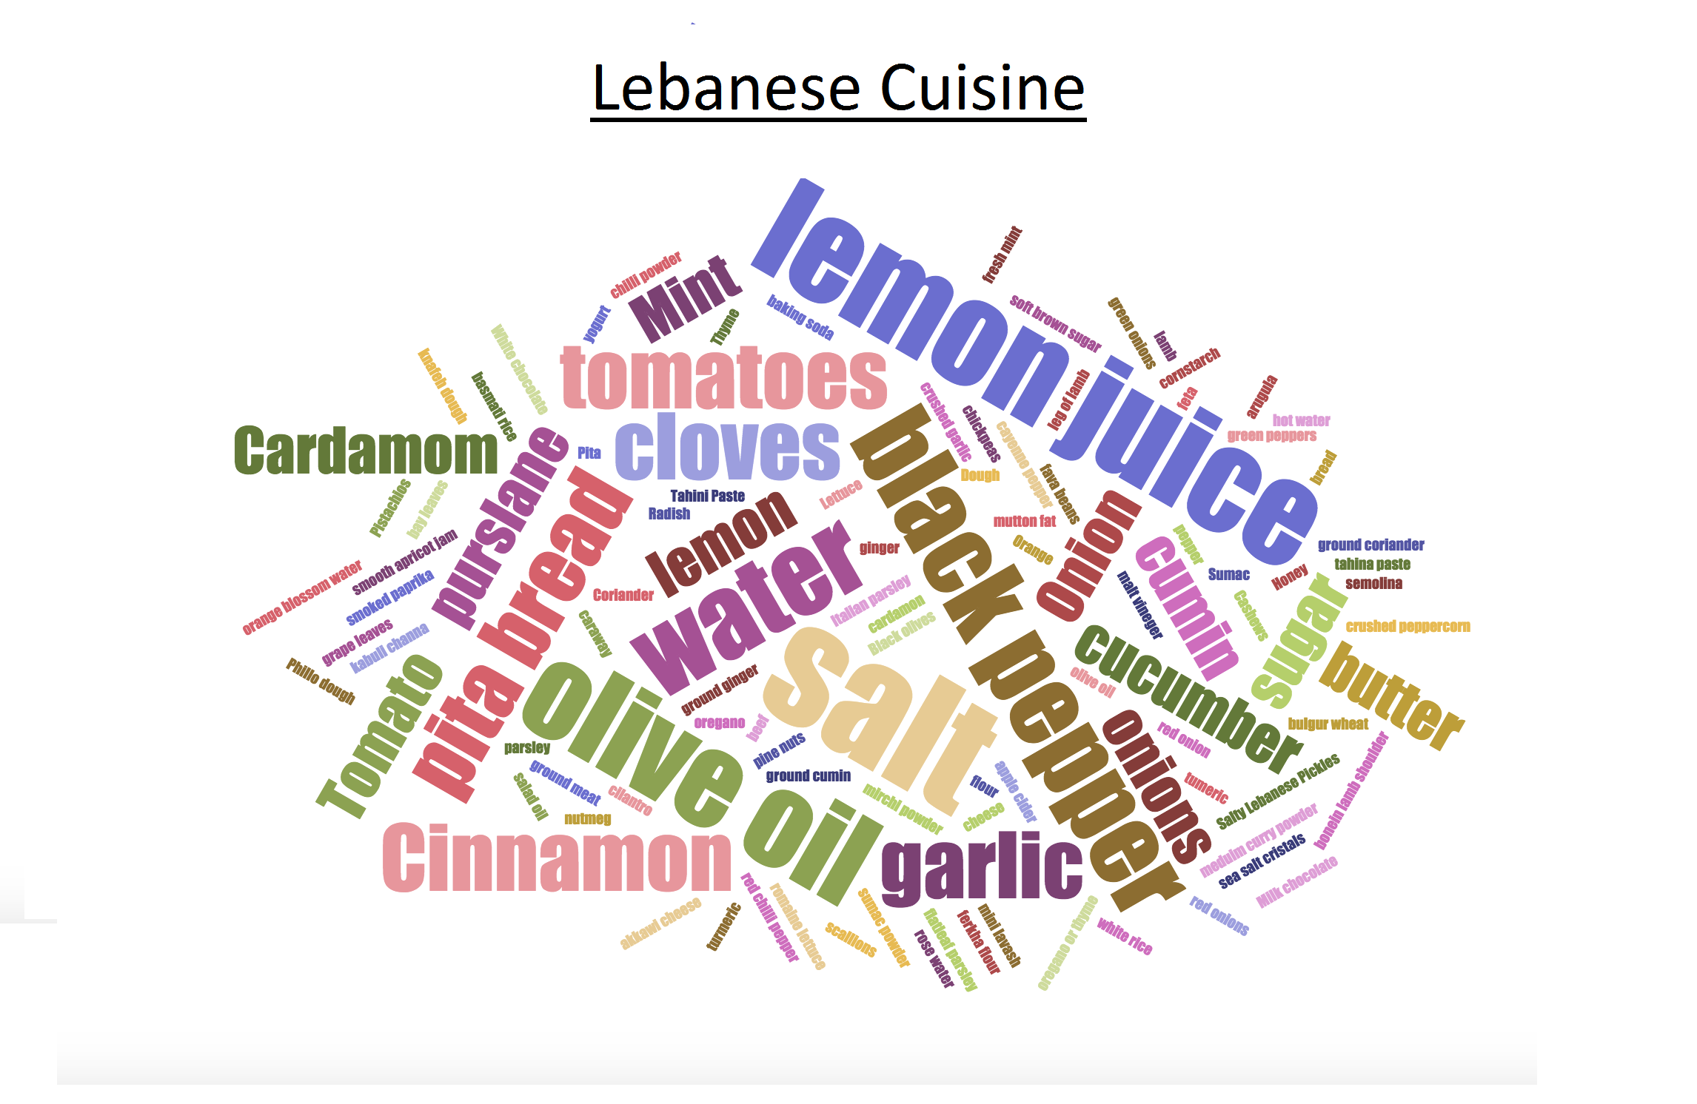
Ingredients analysis of Asian Cuisines

Slide 8
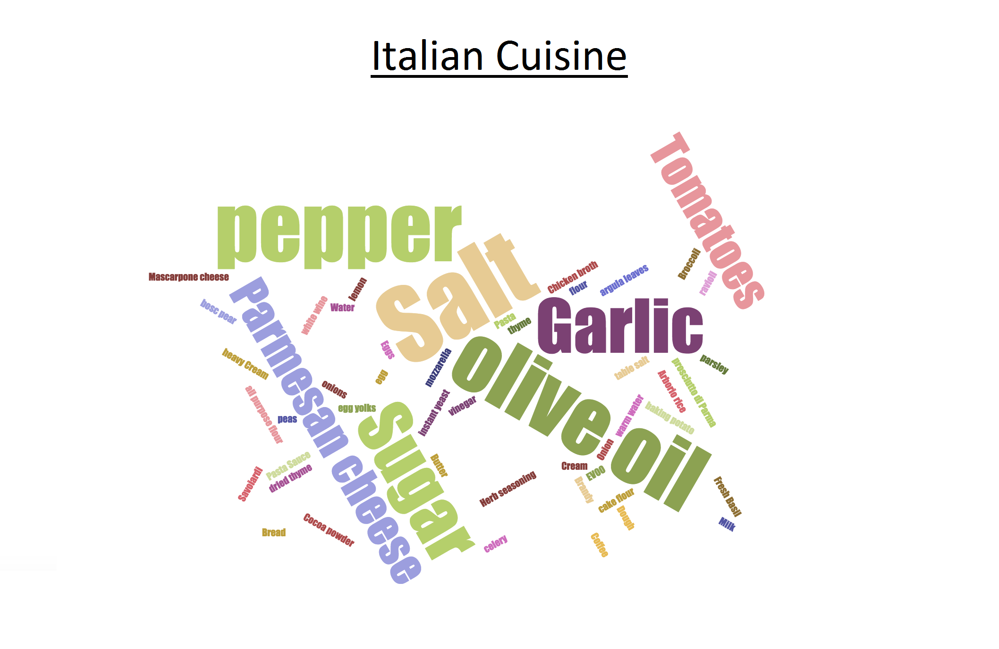
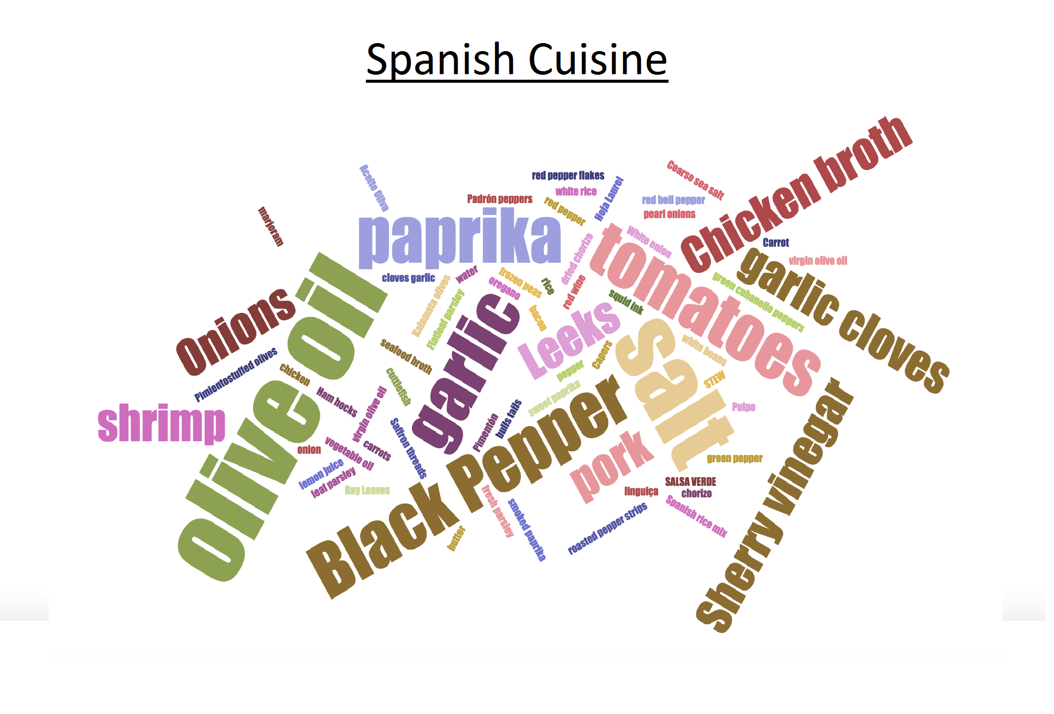
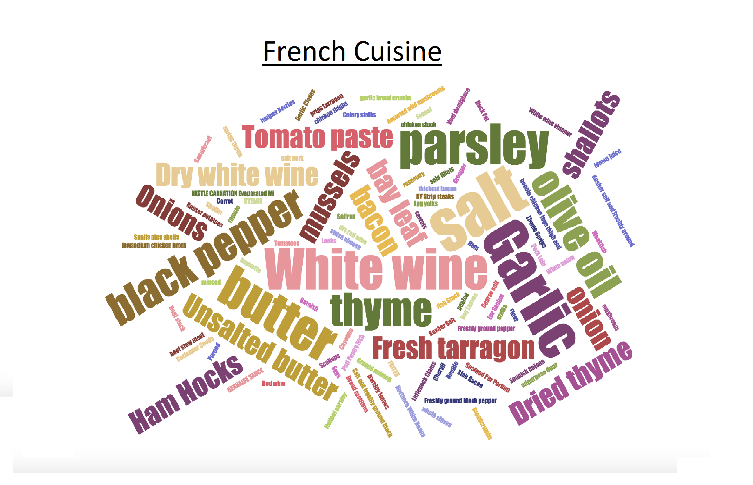
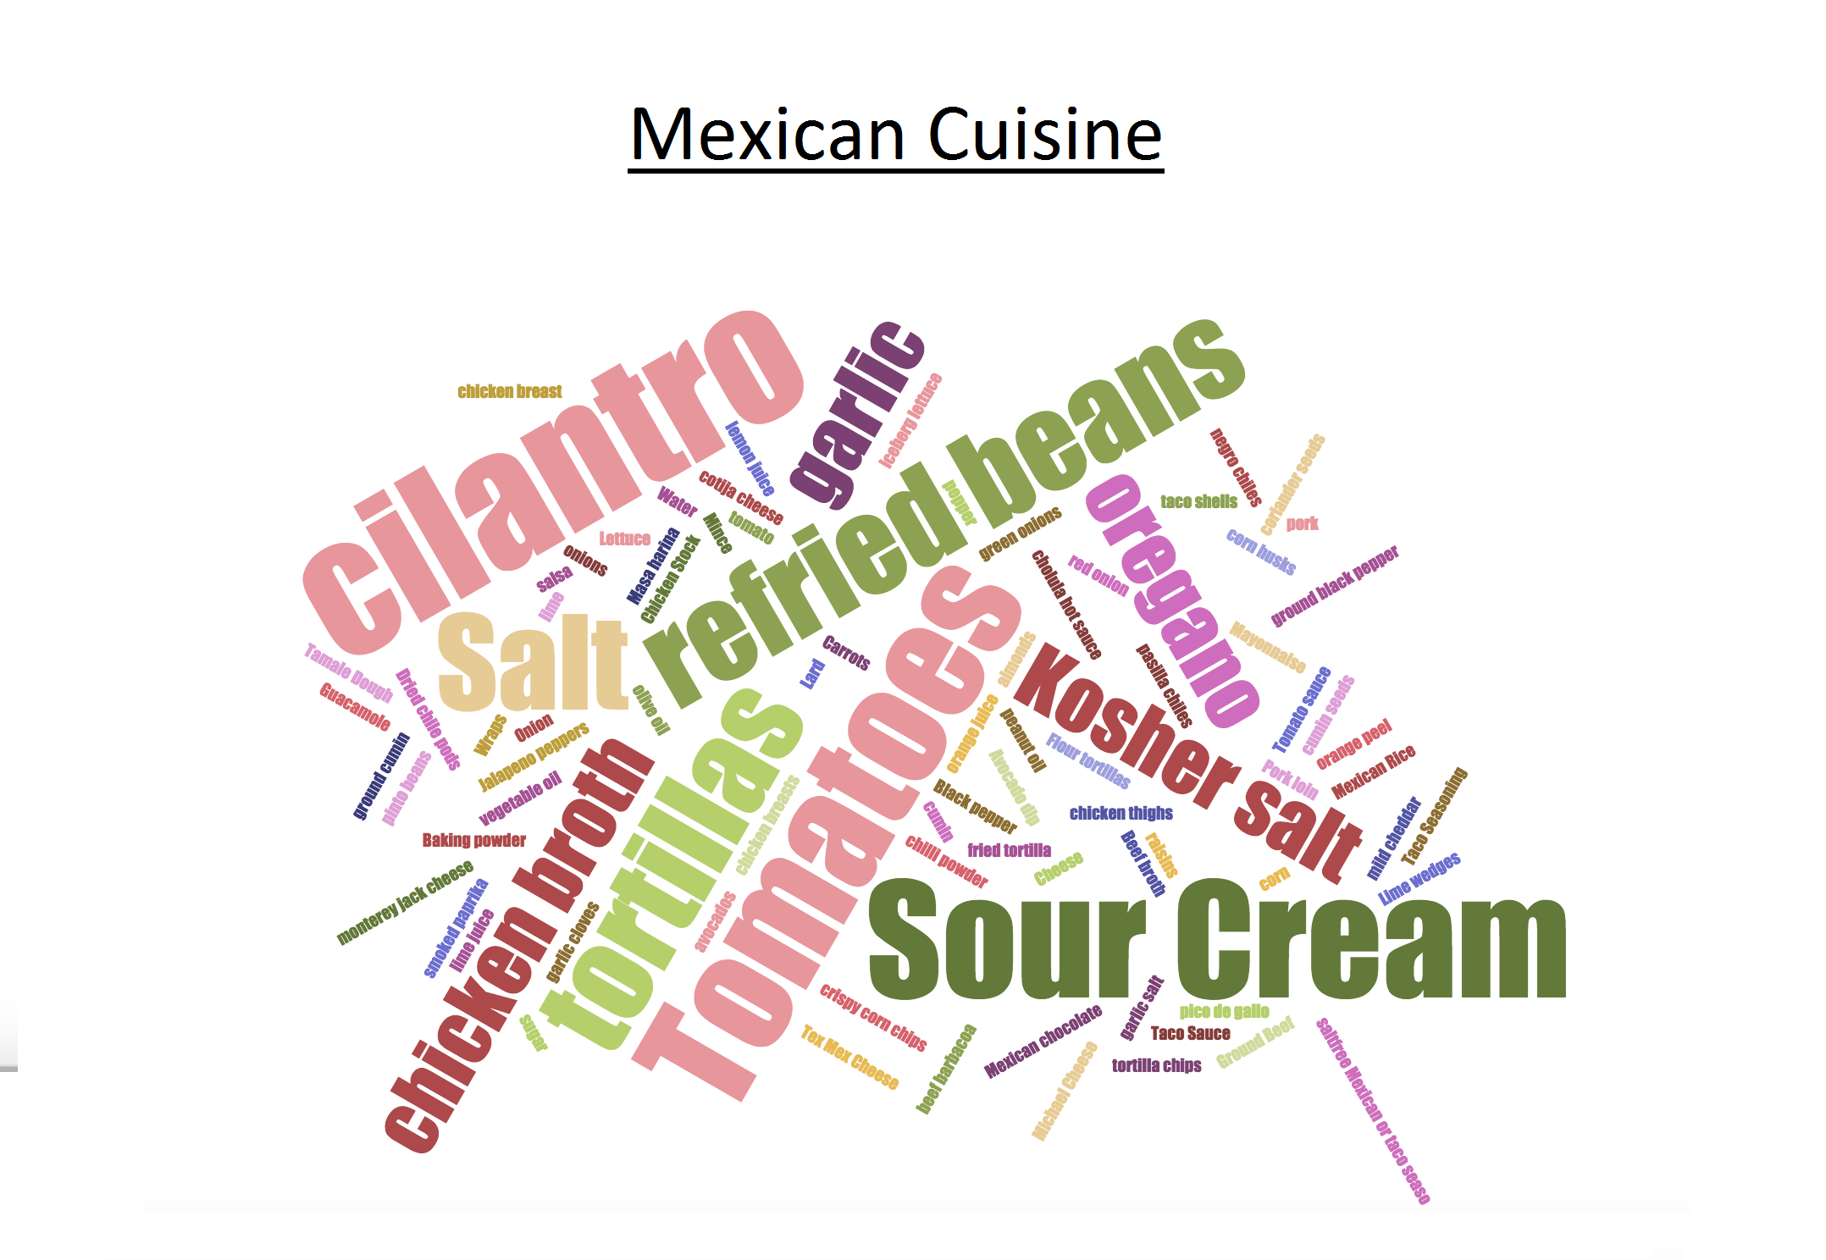
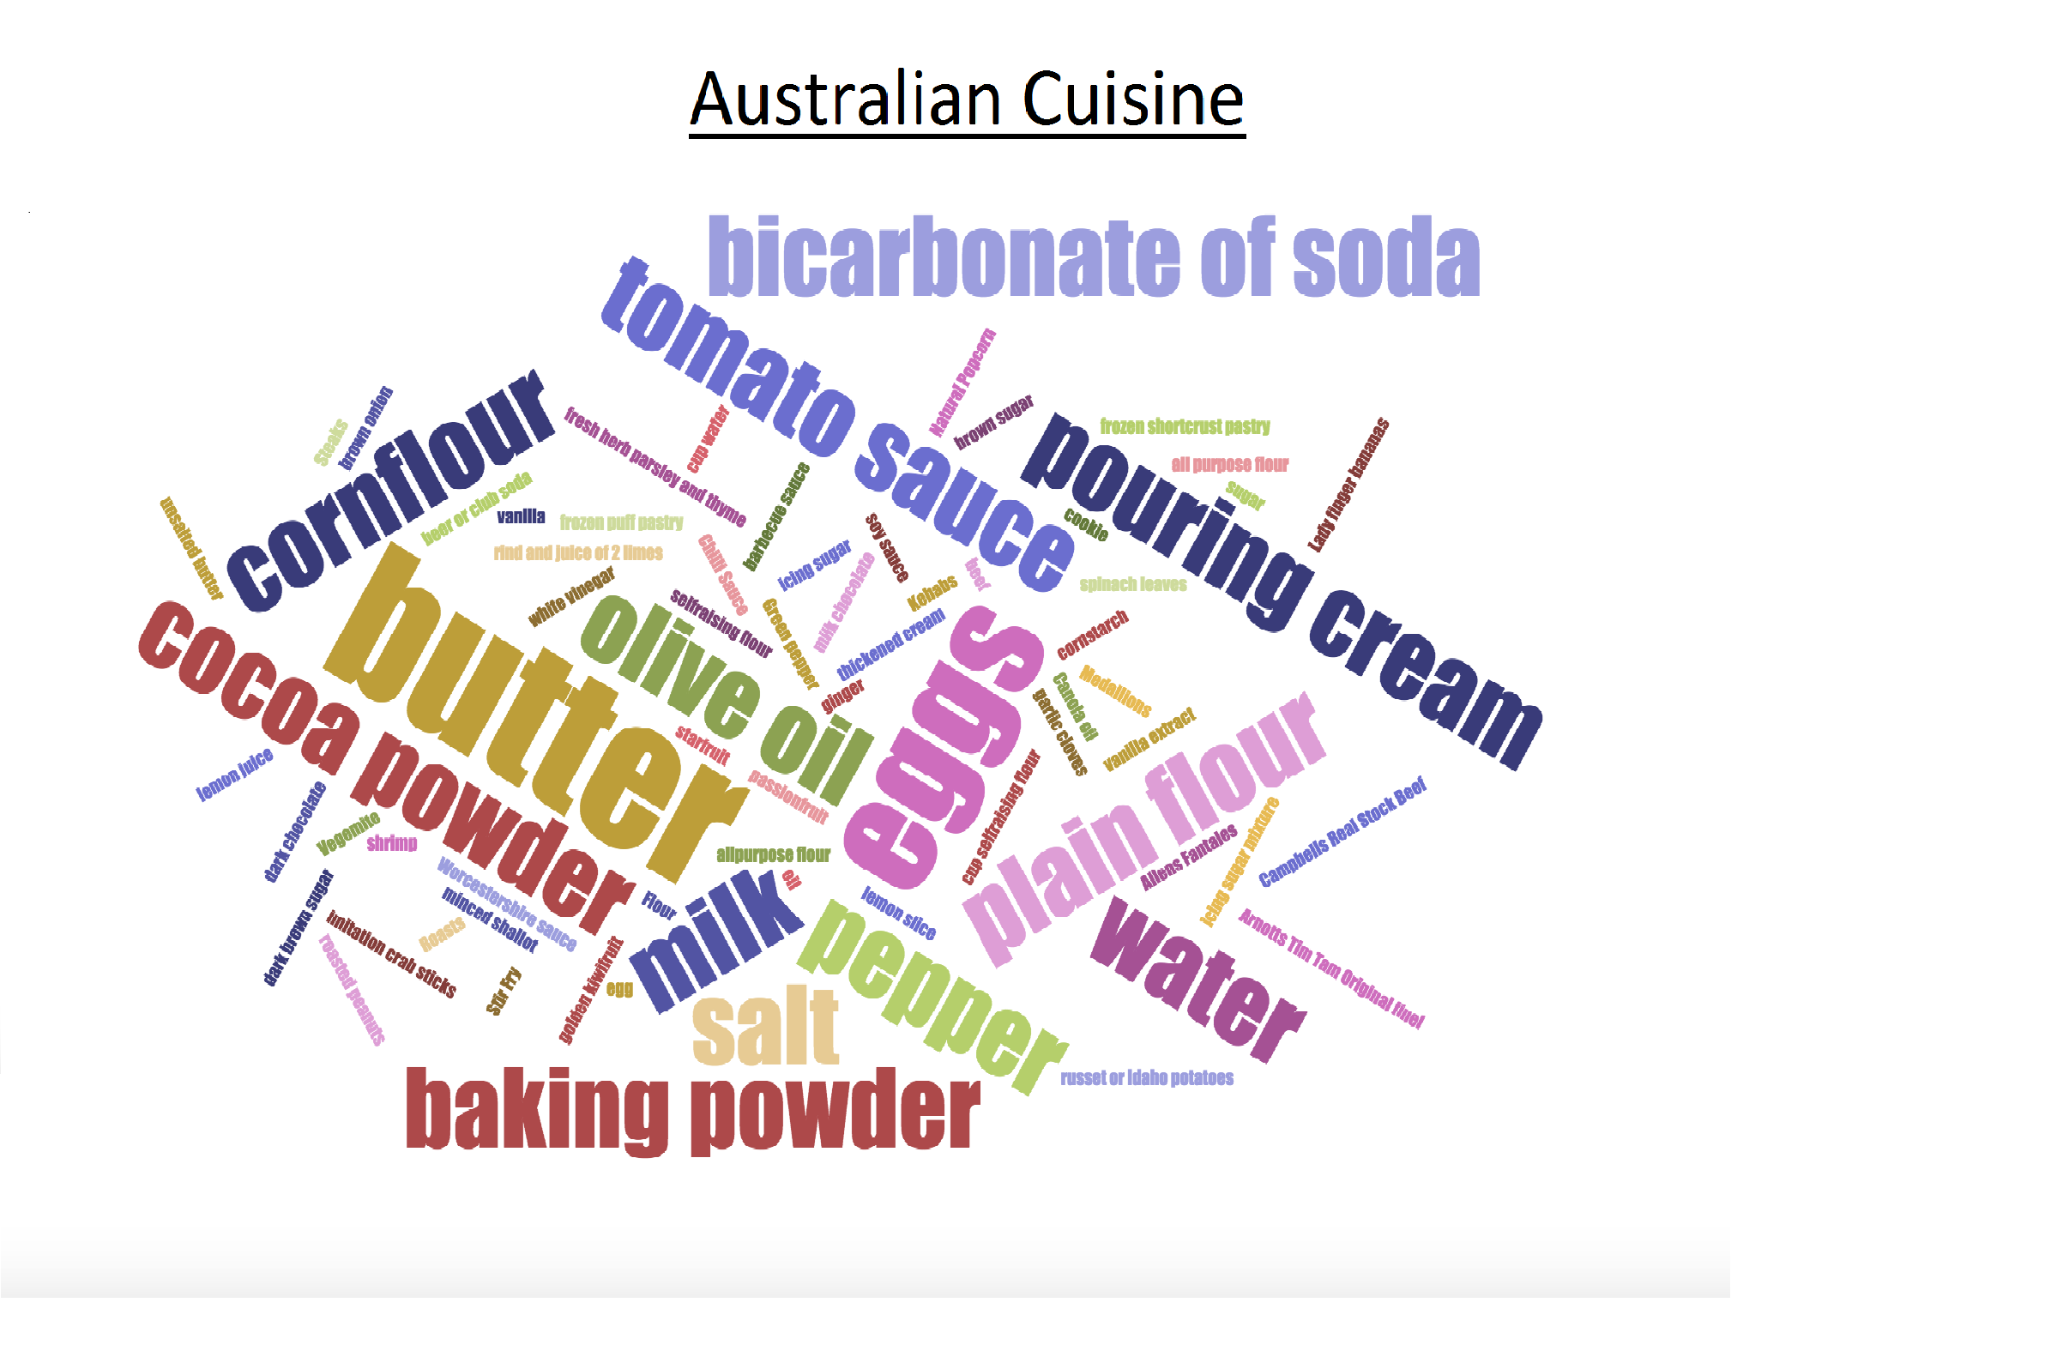
Ingredients analysis of Western Cuisines

Slide 9
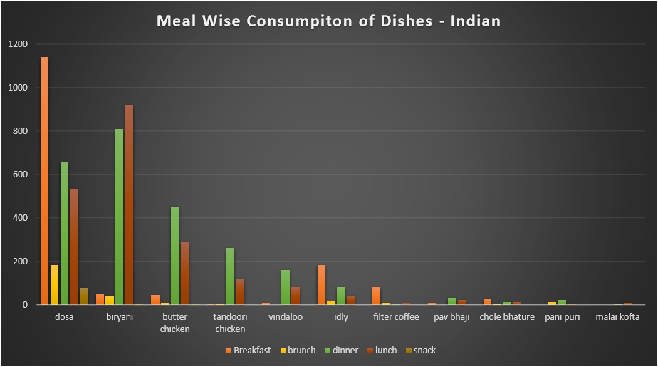
Clustered Column graph - To find preferences of dishes over different meals of the day.

Slide 10
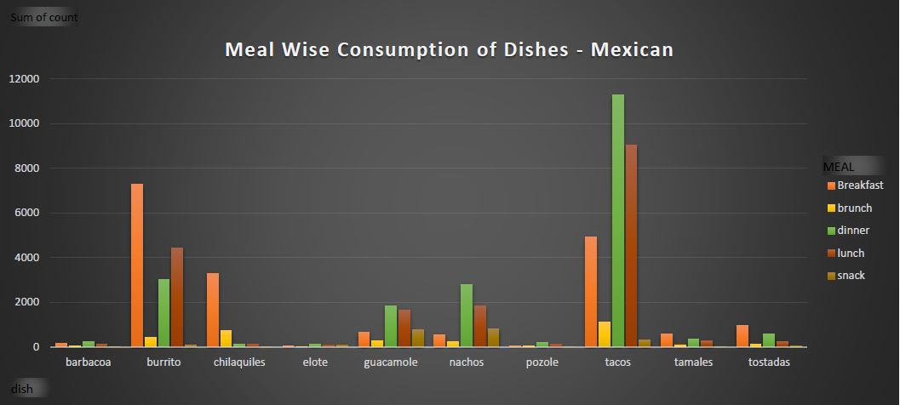
Clustered Column graph - To find preferences of dishes over different meals of the day.

Slide 11
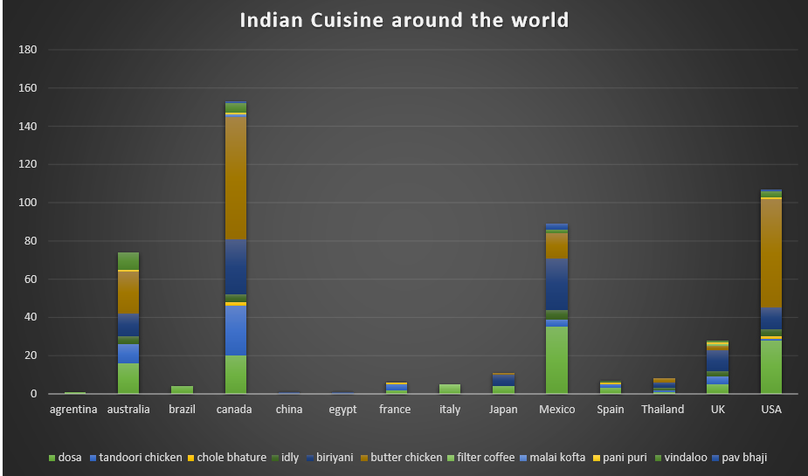
Stacked Bar – To find the affinity of a particular cuisine among different countries.

Slide 12
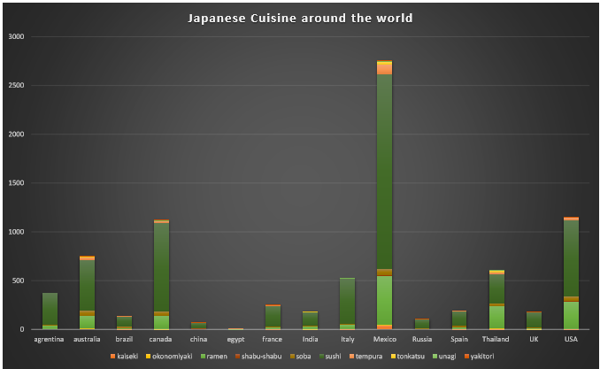
Stacked Bar – To find the affinity of a particular cuisine among different countries.

Slide 13
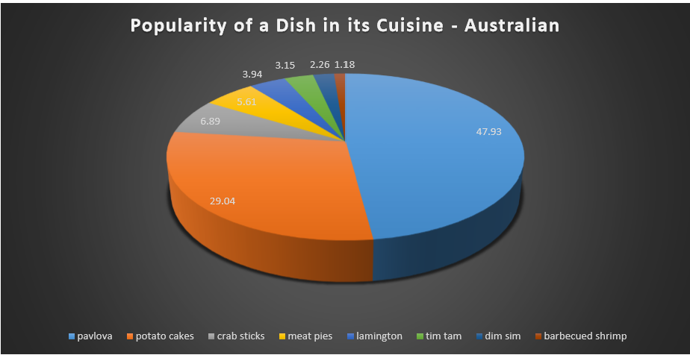
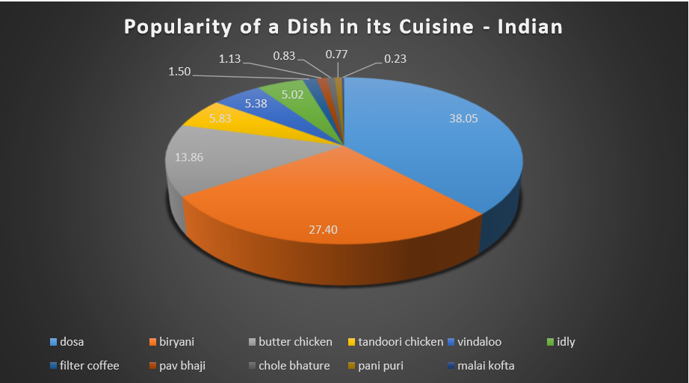
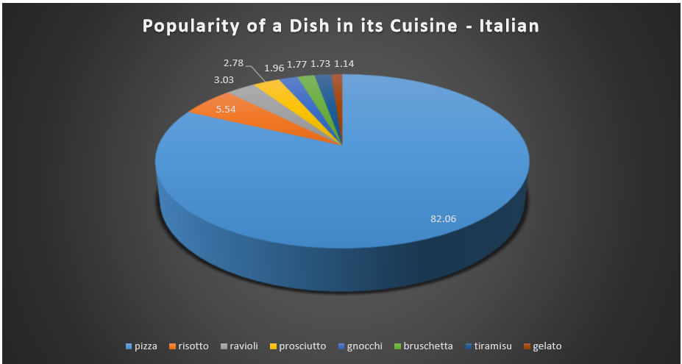
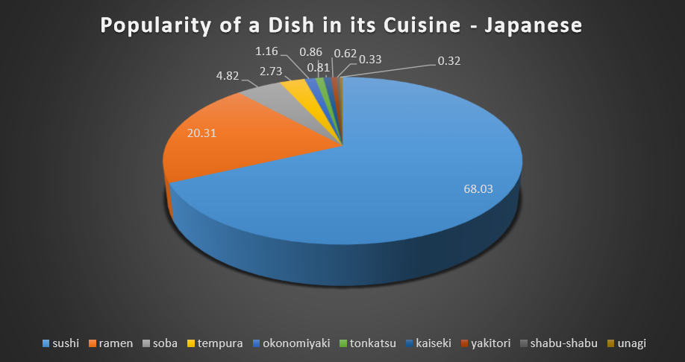
Pie Charts - To find the share of all dishes in a particular cuisine

Slide 14
Geo Maps – To find the top dishes in a country
file:///Users/pmmercha/Downloads/final%20maps%20(2).html

Slide 15
Results & Conclusions so far
Few Popular dishes like Pizza and Sushi are popular all around the world. Pizza is eaten all over the world and our results showed that Italian cuisine dominates world food, and 80% of the contribution is by pizza.
Mexicans explore a lot of cuisines and are also very active on Twitter. US and UK too are extremely active and try out dishes.
There is a clear preference to some dishes in each cuisine – Chorizo in Spain.
In each cuisine ,not all dishes are eaten during different meals - Eg. Dosa for breakfast , Biryani for lunch and Butter Chicken for dinner.
More common ingredients are present in cuisines of neighboring countries. Influence of dishes across neighboring countries is high.
Countries with similar weather also tend to have similar food habits. Australia and Mexico.

Slide 16
Future work
Mine and explore more cuisines
Find how similar are 2 dishes across cuisines
Can the choice of cuisine determine the nationality of the user.

Slide 17
Thank you

